Slide 1
PATI MEHARLAKSHMI
FINAL PROJECT

Slide 2
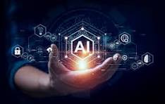
ARTIFICIAL INTELLIGENCE
Artificial intelligence, or AI, is technology that enables computers and machines to simulate human intelligence and problem-solving capabilities.

Slide 3
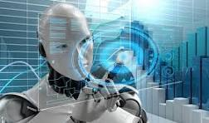
ARTIFICIAL INTELLIGENCE
INTRODUCTION
TO
Artificial Intelligence (AI) is a branch of computer science focused on creating systems capable of performing tasks that typically require human intelligence. These tasks include learning, reasoning, problem-solving, perception, language understanding, and more. Here's a brief introduction to AI:

Slide 4
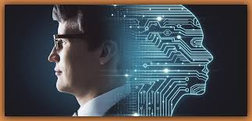
UNDERSTANDING ARTIFICIAL INTELLIGENCE
:
1.Core Concepts of AI
Machine Learning (ML):
Deep Learning
Natural Language Processing (NLP):
Computer Vision:
2.Key AI Techniques
Neural Networks
Decision Trees
Support Vector Machines (SVM):
lusterin Algorithms:

Slide 5
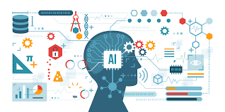
BENEFITS OF ARTIFICIAL INTLLIGENCE IMPLEMENTATION
AI implementation offers transformative benefits that enhance efficiency, accuracy, and innovation across various sectors. By automating routine tasks, providing deep insights from data, and enabling new products and services, AI has the potential to revolutionize industries and improve the quality of life. However, it is crucial to address the ethical and societal implications to ensure that AI benefits are realized broadly and equitably.

Slide 6

PROBLEM STATEMENT
The problem statement of Artificial Intelligence (AI) refers to the specific issue or challenge that AI systems are designed to solve. It could be anything from natural language processing to computer vision tasks or even complex decision-making problems.

Slide 7
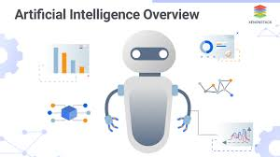
PROJECT OVERVIEW
At its core, artificial intelligence involves the development of computer systems that can perform tasks typically requiring human intelligence. This includes problem-solving, decision-making, language understanding, and even visual perception.

Slide 8
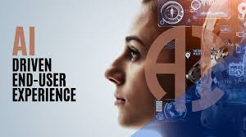
END USERS
Regarding the end users of AI systems, the literature distinguishes between individuals voluntarily using AI systems and individuals affected by decisions made by AI systems (Meske et al., 2022). In addition, there are two stakeholder groups overseeing AI systems from different perspectives.

Slide 9
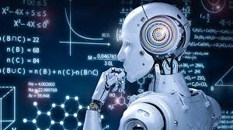
SOLUTIONS
AlphaBOLD specializes in providing artificial intelligence solutions that transition businesses from initial interest in AI to practical application, ensuring measurable benefits. We equip companies for AI adoption by harmonizing their data, workforce, and processes within a secure, cloud-based framework. This infrastructure not only supports continuous innovation but also fosters growth, efficiency, and resilience responsibly.

Slide 10
WOW IN THIS SOLUTIONS
Wow AI is your ultimate AI training partner, offering a comprehensive platform for end-to-end AI development. Our platform includes diverse foundation models in NLP, computer vision, and audio, all free to use. We also provide AI data products such as a huge pool of OTS datasets, custom data collection, data labeling services and crowdsourcing services.

Slide 11
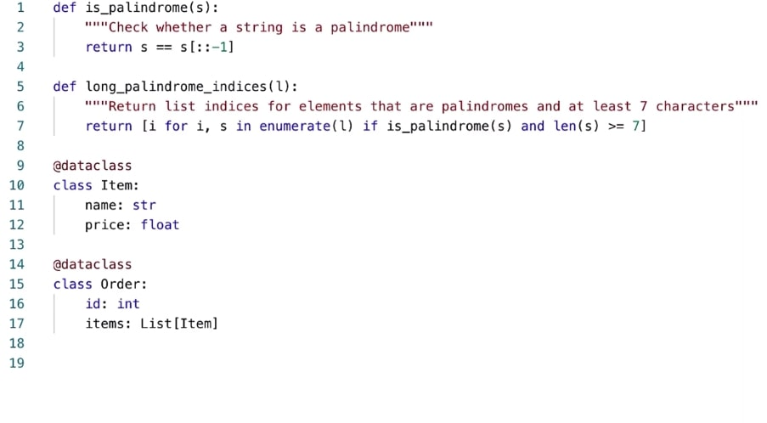
MODELLING
AI models or artificial intelligence models are programs that detect specific patterns using a collection of data sets. It is an illustration of a system that can receive data inputs and draw conclusions or conduct actions depending on those conclusions.

Slide 12
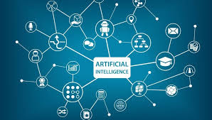
RESULT
AI-powered systems can analyze real-time data from sensors, cameras, and other sources to make quick and informed decisions. This can enable features such as advanced driver assistance systems (ADAS) and autonomous vehicles, which can help reduce human error and accidents.

Slide 13
https://github.com/techtrainer20/APSSDC.git

